Slide 1
Optical Flow
Lecture 09-04
RBE500
Adj. Prof. J Center

Slide 2
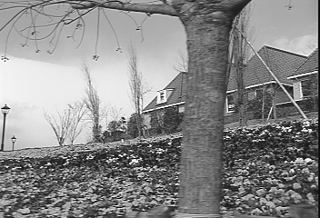
Lecture 9
Optical Flow, Feature Tracking, Normal Flow
Gary Bradski
Sebastian Thrun
*
http://robots.stanford.edu/cs223b/index.html
* Picture from Khurram Hassan-Shafique CAP5415 Computer Vision 2003

Slide 3
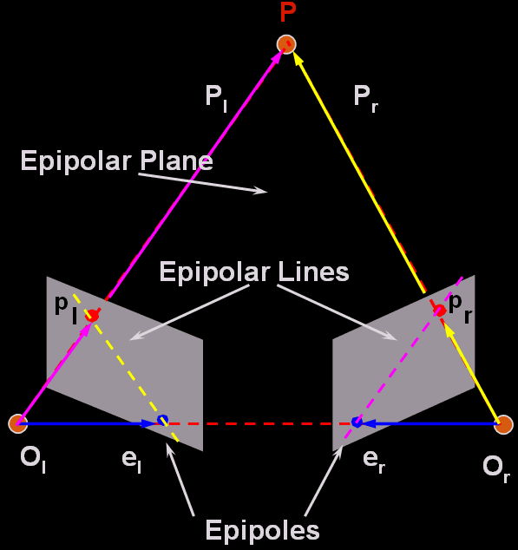
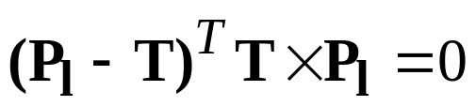

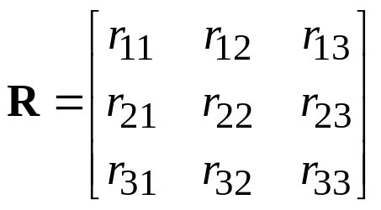
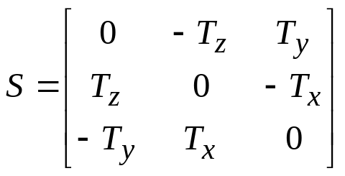
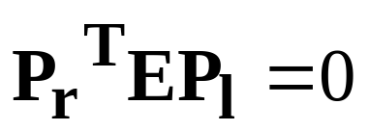
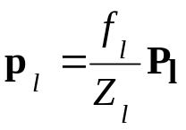
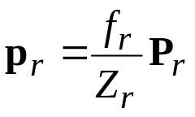
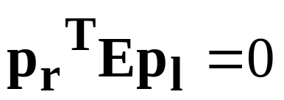
Q from stereo about
Essential Matrix
(from Trucco P-153)
Equation of the epipolar plane
  Co-planarity condition of vectors P_{l}, T and P_{l}-T
Essential Matrix E = RS
  3x3 matrix constructed from R and T (extrinsic only)
    Rank (E) = 2, two equal nonzero singular values
Rank (R) =3
Rank (S) =2
Why is this zero if it’s not orthogonal?
Notes:
The projection of TxPl in vector (Pl-T) is zero

Slide 4
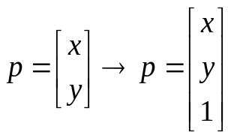
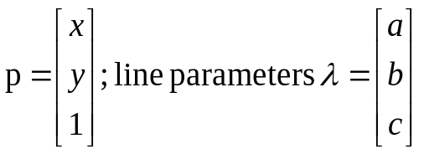

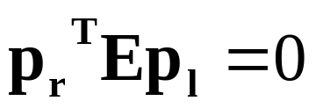
Question:
Why is this zero if it’s not orthogonal?
Answer: We’re dealing with equations of lines in
homogeneous coordinates.
Remember from Sebastian’s lecture, projective equations
are nonlinear because of the scale factor (1/Z). By
adding a generic scale, we get simple linear equations.
Thus, a point in the image plane is expressed as:
For a line:
Equation
Thus,
represents the projection of the line p_{l} onto the right image
plane.
So,
is the equation of the line in the right image written in terms
of the point p_{l}. That is, a statement that the point p_{l} lies on
the that line.

Slide 5
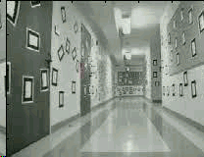
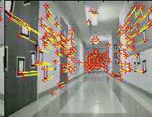
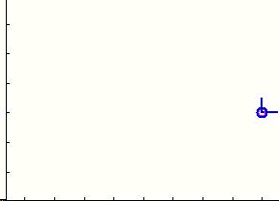
Optical Flow
Image tracking
3D computation
Image sequence
(single camera)
Tracked sequence
3D structure
+
3D trajectory

Slide 6
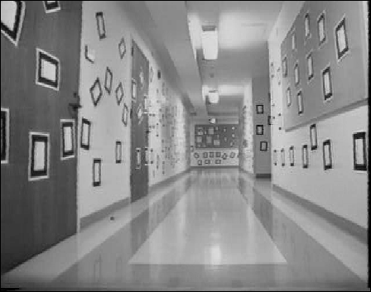












What is Optical Flow?
Optical Flow
Velocity vectors
Optical flow is the relation of the motion field
  the 2D projection of the physical movement of points relative to the observer
to 2D displacement of pixel patches on the image plane.
Common assumption:
The appearance of the image patches do not change (brightness constancy)
Note: more elaborate tracking models can be adopted if more frames are process all at once

Slide 7
What is Optical Flow?
Optical flow is the relation of the motion field
  the 2D projection of the physical movement of points relative to the observer
to 2D displacement of pixel patches on the image plane.
When/where does this break down?
E.g.: In what situations does the displacement of pixel patches
not represent physical movement of points in space?
1. Well, TV is based on illusory motion
  – the set is stationary yet things seem to move
2. A uniform rotating sphere
  – nothing seems to move, yet it is rotating
3. Changing directions or intensities of lighting can make things seem to move
  – for example, if the specular highlight on a rotating sphere moves.
4. Muscle movement can make some spots on a cheetah move opposite direction of motion.
  – And infinitely more break downs of optical flow.

Slide 8
Optical Flow Break Down
Perhaps an aperture problem discussed later.
➔
* From Marc Pollefeys COMP 256 2003

Slide 9
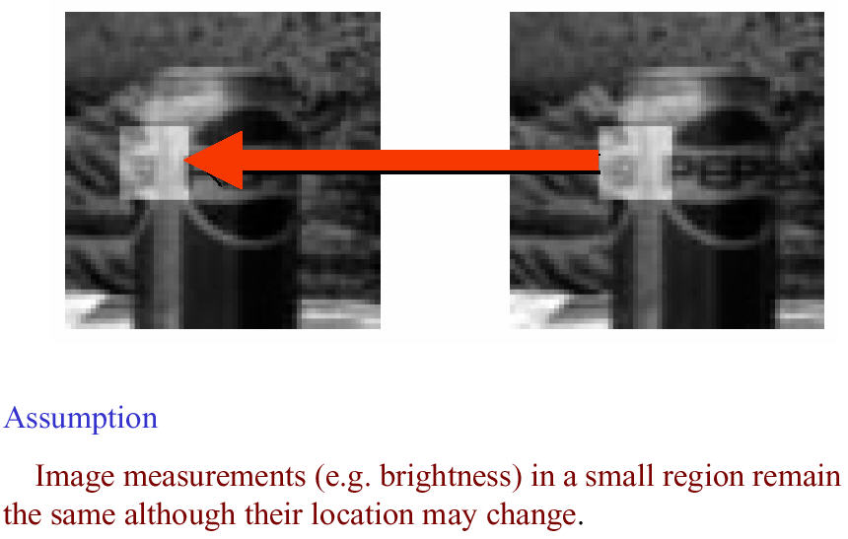
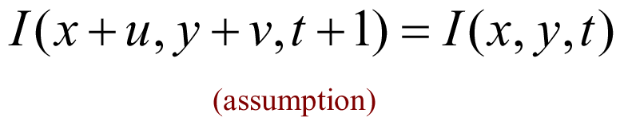
Optical Flow Assumptions:
Brightness Constancy
* Slide from Michael Black, CS143 2003

Slide 10
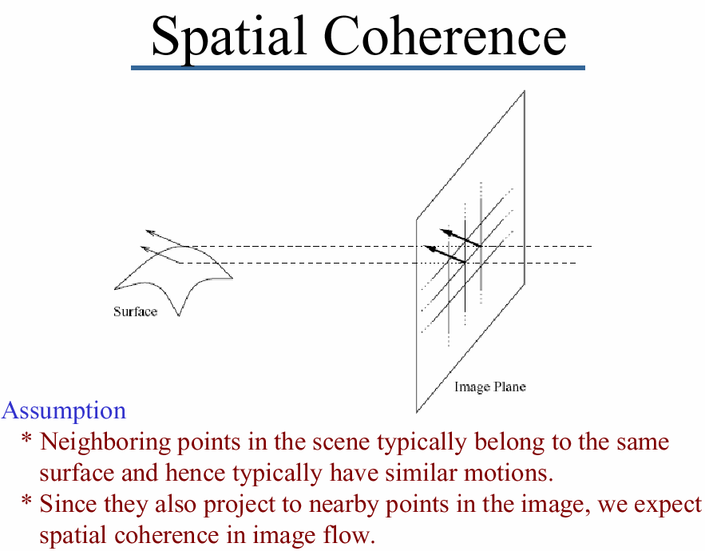
Optical Flow Assumptions:
* Slide from Michael Black, CS143 2003

Slide 11
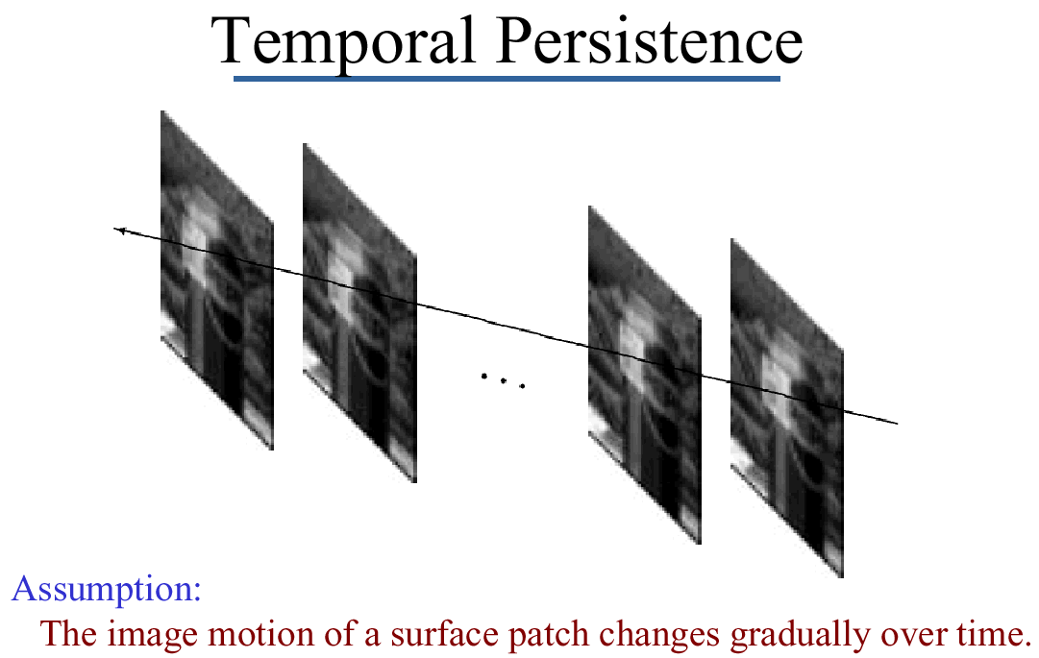
Optical Flow Assumptions:
* Slide from Michael Black, CS143 2003

Slide 12
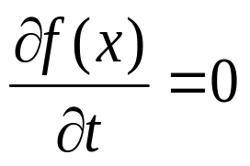
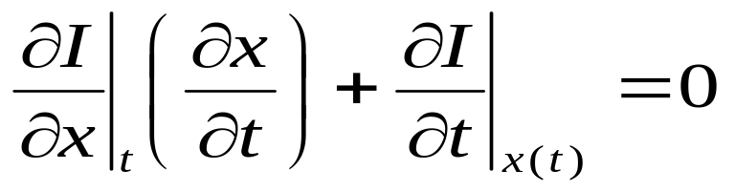
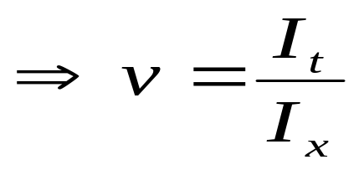
Optical Flow: 1D Case
Brightness Constancy Assumption:
{
Because no change in brightness with time
I_{x}
v
I_{t}

Slide 13





Tracking in the 1D case:
?

Slide 14



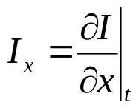
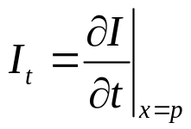
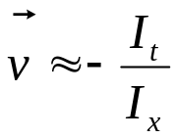
Tracking in the 1D case:
Temporal derivative
Spatial derivative
Assumptions:
Brightness constancy
Small motion

Slide 15
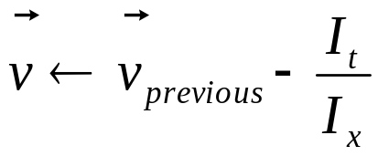
Tracking in the 1D case:
Iterating helps refining the velocity vector
Temporal derivative at 2nd iteration
Can keep the same estimate for spatial derivative
Converges in about 5 iterations

Slide 16




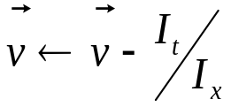

Algorithm for 1D tracking:
For all pixel of interest p:
Compute local image derivative at p:
Initialize velocity vector:
Repeat until convergence:
  Compensate for current velocity vector:
  Compute temporal derivative:
  Update velocity vector:
Requirements:
Need access to neighborhood pixels round p to compute
Need access to the second image patch, for velocity compensation:
  The pixel data to be accessed in next image depends on current velocity estimate (bad?)
  Compensation stage requires a bilinear interpolation (because v is not integer)
The image derivative needs to be kept in memory throughout the iteration process

Slide 17
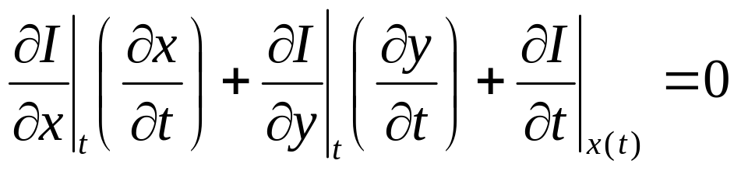
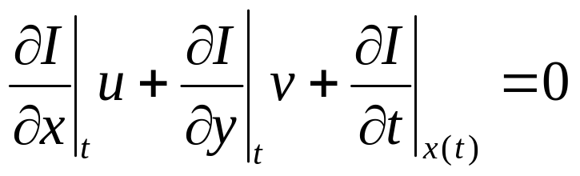
From 1D to 2D tracking
1D:
2D:
Shoot! One equation, two velocity (u,v) unknowns…

Slide 18
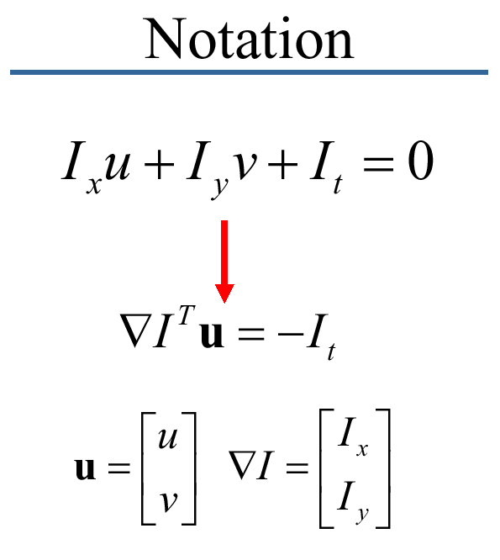
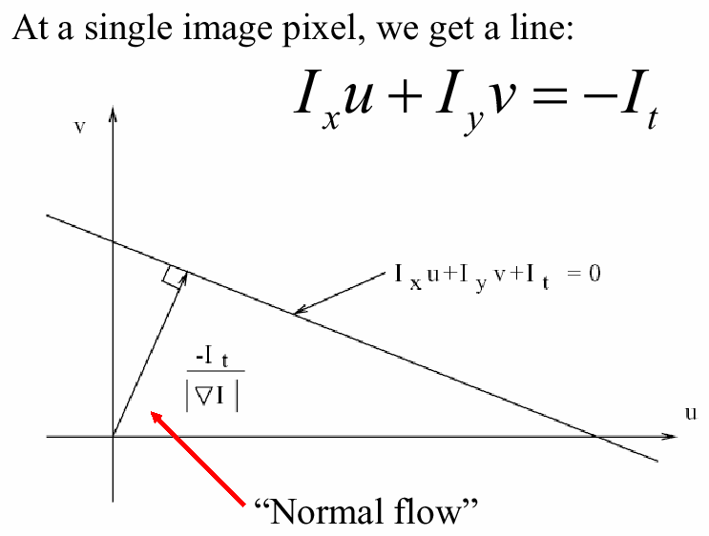
From 1D to 2D tracking
We get at most “Normal Flow” – with one point we can only detect movement
perpendicular to the brightness gradient. Solution is to take a patch of pixels
Around the pixel of interest.
* Slide from Michael Black, CS143 2003

Slide 19
How does this show up visually?
Known as the “Aperture Problem”

Slide 20
Aperture Problem Exposed
Motion along just an edge is ambiguous

Slide 21
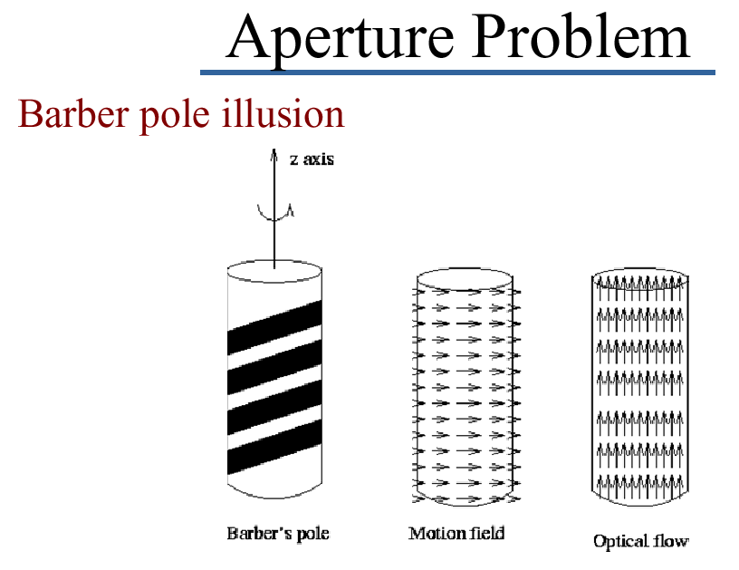
Aperture Problem in Real Life

Slide 22








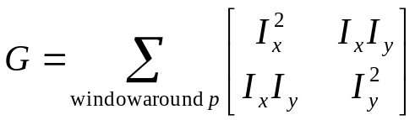
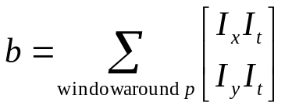
From 1D to 2D tracking
The Math is very similar:
Aperture problem
Window size here ~ 11x11

Slide 23
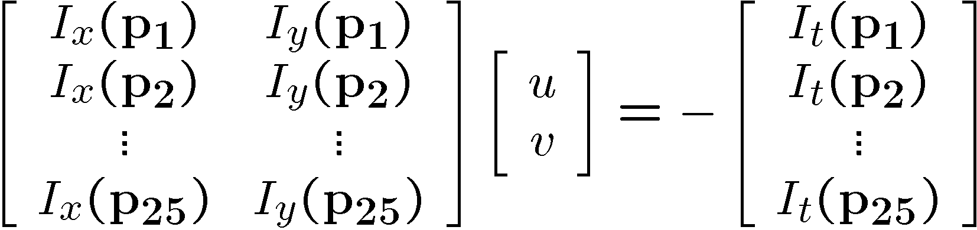



More Detail:
Solving the aperture problem
How to get more equations for a pixel?
  Basic idea: impose additional constraints
    most common is to assume that the flow field is smooth locally
    one method: pretend the pixel’s neighbors have the same (u,v)
      If we use a 5x5 window, that gives us 25 equations per pixel!
* From Khurram Hassan-Shafique CAP5415 Computer Vision 2003

Slide 24
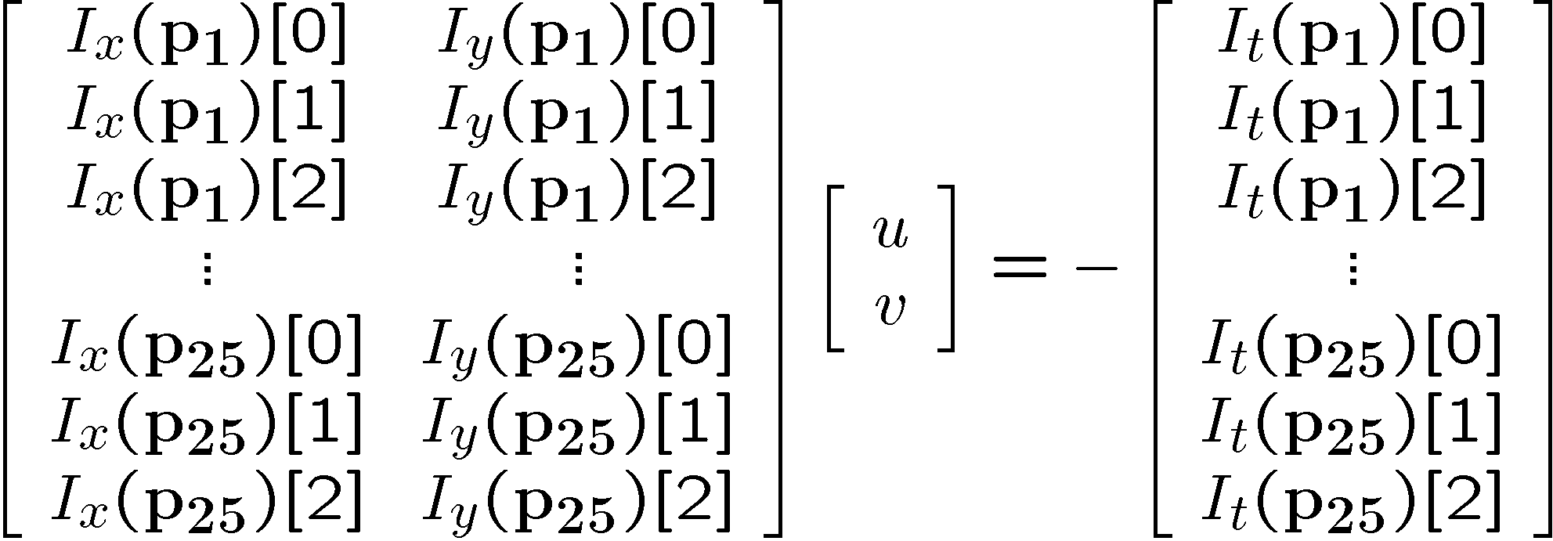


RGB version
How to get more equations for a pixel?
  Basic idea: impose additional constraints
    most common is to assume that the flow field is smooth locally
    one method: pretend the pixel’s neighbors have the same (u,v)
      If we use a 5x5 window, that gives us 25*3 equations per pixel!
* From Khurram Hassan-Shafique CAP5415 Computer Vision 2003

Slide 25







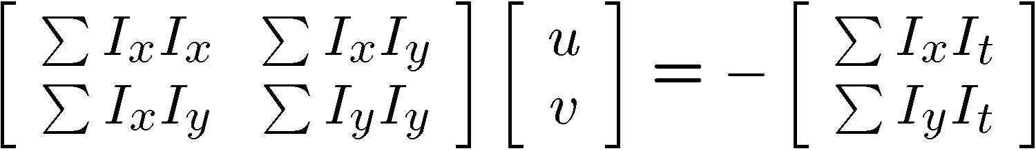


Lukas-Kanade flow
Prob: we have more equations than unknowns
Solution: solve least squares problem
  minimum least squares solution given by solution (in d) of:
  The summations are over all pixels in the K x K window
  This technique was first proposed by Lukas & Kanade (1981)
    described in Trucco & Verri reading
* From Khurram Hassan-Shafique CAP5415 Computer Vision 2003

Slide 26
Conditions for solvability
  Optimal (u, v) satisfies Lucas-Kanade equation
When is This Solvable?
  A^{T}A should be invertible
  A^{T}A should not be too small due to noise
    eigenvalues λ₁ and λ₂ of A^{T}A should not be too small
  A^{T}A should be well-conditioned
    λ₁/ λ₂ should not be too large (λ₁ = larger eigenvalue)
* From Khurram Hassan-Shafique CAP5415 Computer Vision 2003

Slide 27
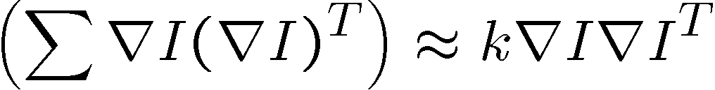
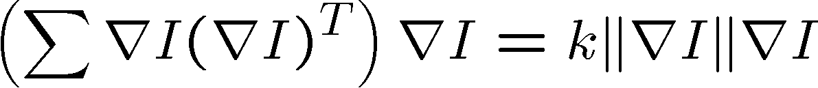


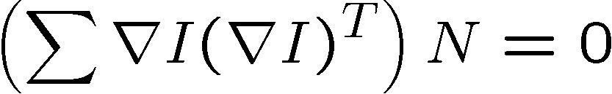
Eigenvectors of A^{T}A
  gradients along edge all point the same direction
  gradients away from edge have small magnitude
  is an eigenvector with eigenvalue
  What’s the other eigenvector of A^{T}A?
    let N be perpendicular to
    N is the second eigenvector with eigenvalue 0
The eigenvectors of A^{T}A relate to edge direction and magnitude
Suppose (x,y) is on an edge. What is A^{T}A?
* From Khurram Hassan-Shafique CAP5415 Computer Vision 2003
Notes:
Suppose M = vv^T . What are the eigenvectors and eigenvalues? Start by considering Mv

Slide 28
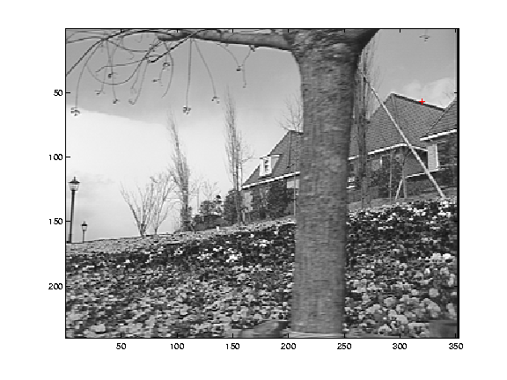
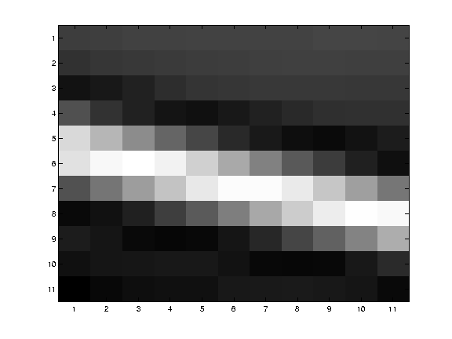
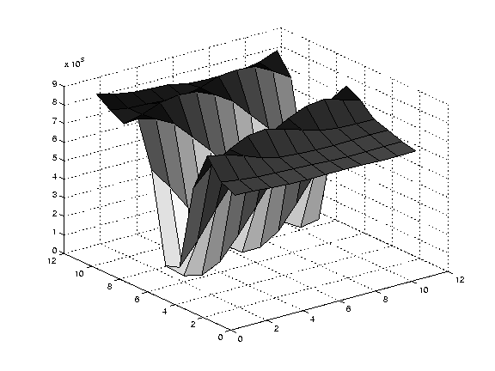
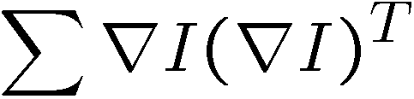
Edge
large gradients, all the same
large λ₁, small λ₂
* From Khurram Hassan-Shafique CAP5415 Computer Vision 2003

Slide 29
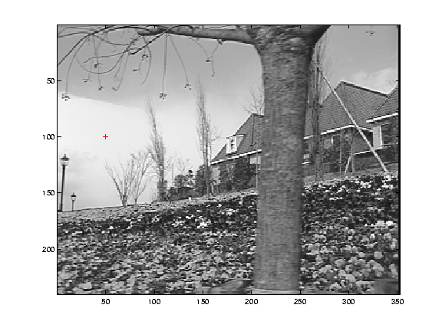
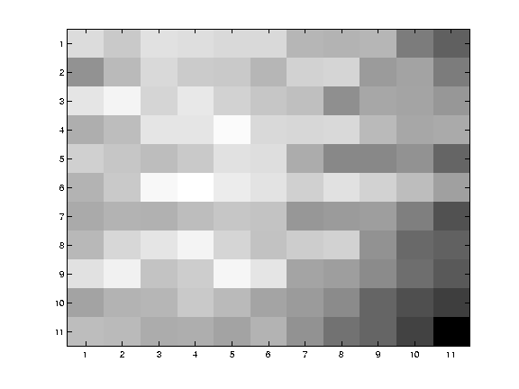
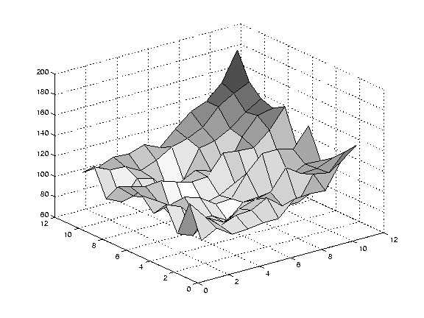
Low texture region
gradients have small magnitude
small λ₁, small λ₂
* From Khurram Hassan-Shafique CAP5415 Computer Vision 2003

Slide 30
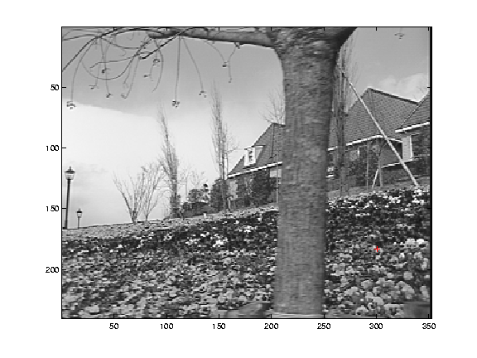
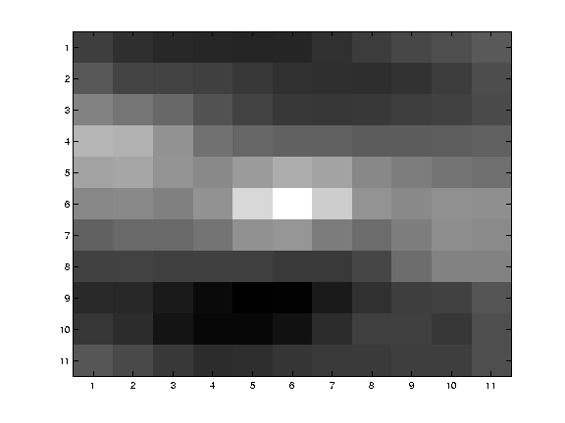

High textured region
gradients are different, large magnitudes
large λ₁, large λ₂
* From Khurram Hassan-Shafique CAP5415 Computer Vision 2003

Slide 31
Observation
This is a two image problem BUT
  Can measure sensitivity by just looking at one of the images!
  This tells us which pixels are easy to track, which are hard
    very useful later on when we do feature tracking...
* From Khurram Hassan-Shafique CAP5415 Computer Vision 2003

Slide 32
Errors in Lukas-Kanade
What are the potential causes of errors in this procedure?
  Suppose A^{T}A is easily invertible
  Suppose there is not much noise in the image
When our assumptions are violated
  Brightness constancy is not satisfied
  The motion is not small
  A point does not move like its neighbors
    window size is too large
    what is the ideal window size?
* From Khurram Hassan-Shafique CAP5415 Computer Vision 2003

Slide 33
Improving accuracy
Recall our small motion assumption
I_{t-1}(x,y)
I_{t-1}(x,y)
This is not exact
  To do better, we need to add higher order terms back in:
I_{t-1}(x,y)
This is a polynomial root finding problem
  Can solve using Newton’s method
    Also known as Newton-Raphson method
  Lukas-Kanade method does one iteration of Newton’s method
    Better results are obtained via more iterations
* From Khurram Hassan-Shafique CAP5415 Computer Vision 2003

Slide 34
Iterative Refinement
Iterative Lukas-Kanade Algorithm
  Estimate velocity at each pixel by solving Lucas-Kanade equations
  Warp I(t-1) towards I(t) using the estimated flow field
    - use image warping techniques
  Repeat until convergence
* From Khurram Hassan-Shafique CAP5415 Computer Vision 2003

Slide 35
Revisiting the small motion assumption
Is this motion small enough?
  Probably not—it’s much larger than one pixel (2nd order terms dominate)
  How might we solve this problem?
* From Khurram Hassan-Shafique CAP5415 Computer Vision 2003

Slide 36




Reduce the resolution!
* From Khurram Hassan-Shafique CAP5415 Computer Vision 2003

Slide 37
Coarse-to-fine optical flow estimation
u=1.25 pixels
u=2.5 pixels
u=5 pixels
u=10 pixels
image I_{t-1}
image I_{t-1}
image I
image I
Gaussian pyramid of image I_{t-1}
Gaussian pyramid of image I

Slide 38
Coarse-to-fine optical flow estimation
run iterative L-K
warp & upsample
run iterative L-K
.
.
.
image J
image I_{t-1}
image I
image I
Gaussian pyramid of image I_{t-1}
Gaussian pyramid of image I

Slide 39

Multi-resolution Lucas Kanade Algorithm

Slide 40

Optical Flow Results
* From Khurram Hassan-Shafique CAP5415 Computer Vision 2003

Slide 41

Optical Flow Results
* From Khurram Hassan-Shafique CAP5415 Computer Vision 2003

Slide 42


Slide 43

* From Marc Pollefeys COMP 256 2003

Slide 44






Generalization

Slide 45

* From Marc Pollefeys COMP 256 2003

Slide 46

* From Marc Pollefeys COMP 256 2003

Slide 47

Affine Flow
* Slide from Michael Black, CS143 2003

Slide 48


Horn & Schunck algorithm
Additional smoothness constraint :
besides Opt. Flow constraint equation term
minimize es+αec
➔
* From Marc Pollefeys COMP 256 2003

Slide 49



Horn & Schunck algorithm
In simpler terms: If we want dense flow, we need to regularize what happens
in ill conditioned (rank deficient) areas of the image. We take the old cost function:
And add a regularization term to the cost:
where ||d|| is some length metric, typically Euclidian length. When you solve, what
happens to our former solution
?
The above solution requires that G be of full rank, that is, on a corner. Simplified,
what basically happens for the solution in Horn and Schunck is that:
which is always full rank.

Slide 50

What does the regularization do for you?
It’s a sum of squared terms (a Euclidian distance measure).
We’re putting it in the expression to be minimized.
=> In texture free regions, v = 0
=> On edges, points will flow to nearest points.
Regularized flow
Optical flow

Slide 51


Dense Optical Flow ~ Michael Black’s method
Michael Black took this one step further, starting from the regularized cost:
He replaced the inner distance metric, a quadradic:
with something more robust:
?
Where looks something like
Basically, one could say that Michael’s method adds ways to handle
occlusion, non-common fate, and temporal dislocation

Slide 52
Other Kinds of Flow
Feature based – E.g.
  Will not say anything more than identifiable features just lead to a search strategy.
  Of course, search and gradient flow can be combined in the cost term distance measure.
Normal Flow by motion templates
…many others….

Slide 53


Normal Flow by Motion Templates
Davis, Bradski, WACV 2000
Object silhouette
Motion history images
Motion history gradients
Motion segmentation algorithm
Bradski Davis, Int. Jour. of Mach.
Vision Applications 2001
MHG
silhouette
MHI

Slide 54
Motion Template Idea

Slide 55

Motion Segmentation Algorithm
Stamp the current motion history template with the system time and overlay it on top of the others:

Slide 56
Motion Segmentation Algorithm
Measure gradients of the overlaid motion history templates:

Slide 57
Motion Segmentation Algorithm
Threshold large gradients to get rid of motion template edges resulting from too large of a time delay:

Slide 58
Motion Segmentation Algorithm
Find boundaries of most recent motions
“Walk around boundary
If drop not too high, Flood fill downwards to segment motions
Segmented
Motion
Segmented
Motion

Slide 59

Motion Segmentation Algorithm
Actually need a two-pass algorithm for labeling all motion segments:
Fill downwards; At bottom, turn around and fill upwards.
Keep the union of these fills as the segmented motion.

Slide 60


Motion Template for Motion Segmentation and Gesture
Overlay silhouettes, take gradient for normal optical
flow. Flood fill to segment motions.
Motion
Segmentation
Motion
Segmentation
Pose
Recognition
Gesture
Recognition

Slide 61

Human Motion System
Illusory Snakes

